Slide 1
A Home for All
Utilizing the Kaggle PetFinder Adoption Competition to Strategize Animal Intake
Caitlin Janson
December 14, 2020

Slide 2
Agenda
Problem Statement
Dataset
Exploratory Data Analysis
Statistical Analysis
Model Development and Results
Recommendations
Dataset limitations
Opportunities for future work

Slide 3
Problem Statement
The shelters are overpopulated and it seems nothing is working! The client needs to know how can they capitalized on trends to develop a more strategic business plan for adopting out a pet without:
Bothering with “Marketed” descriptions resulting in disappointment and pet returns
Taking the wrong pets to events when they’ll be adopted even with minimal exposure
Long term foster fees when a pet could be transferred to a different rescue and be adopted in under 90 days

Slide 4

Dataset Overview
This project utilizes the Kaggle PetFinder Dataset
Targeted at increasing adoption speeds for homeless pets
Contains over 10,000 animals, including cats and dogs
Sourced from the Malaysian region
Is primarily ordinal data (0,1,2,3) as placeholders for descriptive data (puppy, adolescent, adult, senior)

Slide 5
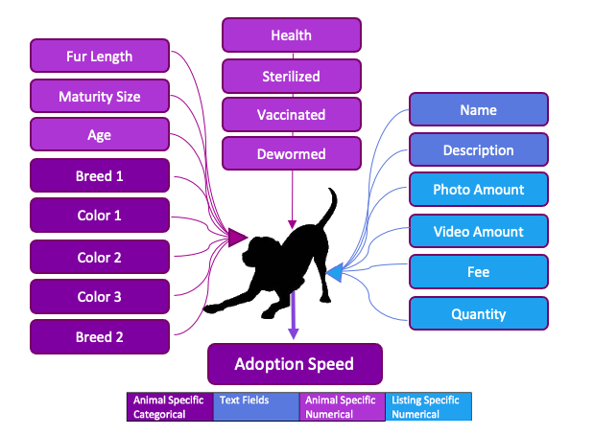
Dataset Overview

Slide 6
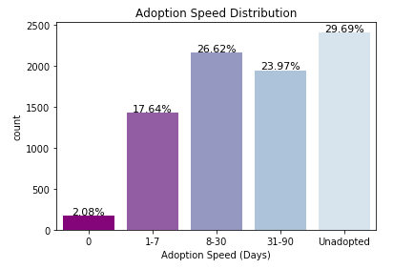
Exploratory Data Analysis- Adoption Speed
Notes:
When looking at the Kaggle dataset it quickly becomes apparent that a large number of dogs are also going unadopted, but not to the severity in the U.S. Approximately 30% of dogs go either unadopted or unreported as being adopted (Fig. 1, Page 4). As expected, a very low number of dogs are adopted on the same day they are listed, at 2.08%

Slide 7
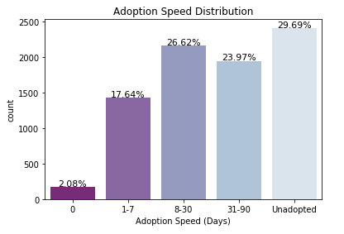
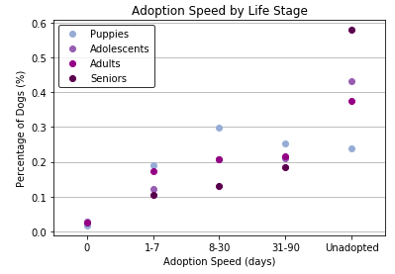
Exploratory Data Analysis- Age
Notes:
Of these animals adopted, the younger dogs are adopted more quickly than the senior, which is consistent with expectations. Statistical testing confirms that there is a relationship between age and adoption speed at a significance level of 95%. Particularly interesting is how strikingly evident the unadoption rate for senior animals is. As expected, puppies tend to be a pretty hot commodity.

Slide 8
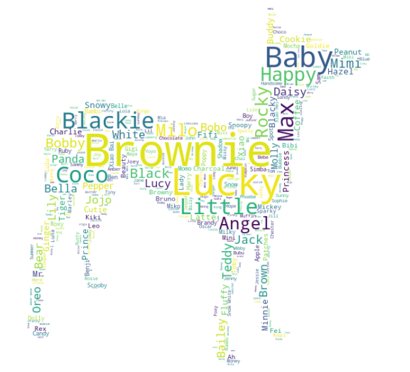
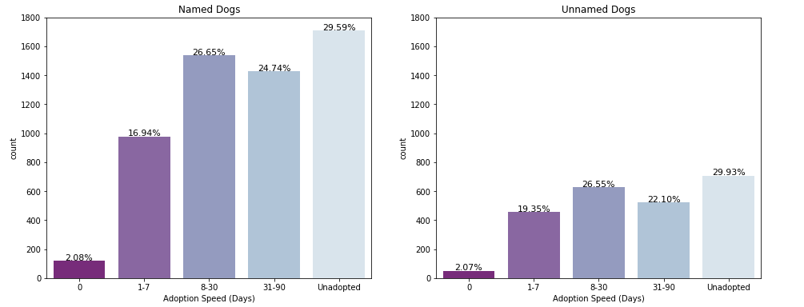
Exploratory Data Analysis - Name
Notes:
When it comes to names and appearance, dogs that have already been given a name tend to be adopted more quickly in the U.S. It’s possible that the presence of a name indicates the dog’s history is known, and it gives a sense of personality. First, the names listed in the dataset were explored to see what were the most popular names, and if they had any bearing on adoption speed. Most often, the color of the animal was its name, with the most popular names in this dataset being “Blackie”, “Brownie”, “Baby” and “Lucky”. Statistical testing showed that the specific name of an animal is independent of adoption speed. However, the presence of a name did matter, and tested as being statistically related to adoption speed

Slide 9
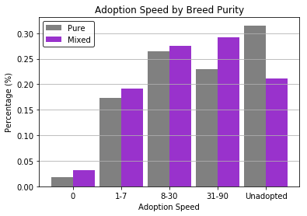
Exploratory Data Analysis- Breed
Notes:
When it comes to breed choices in the U.S., purebred dogs tend to be more popular. Particularly when it comes to labradors and other hunting dogs. The data set seems to demonstrate that in Malaysia this is not the case, with mixed breed dogs being more popular (image to right). This may be due to the availability of mixed breed dogs being higher.

Slide 10
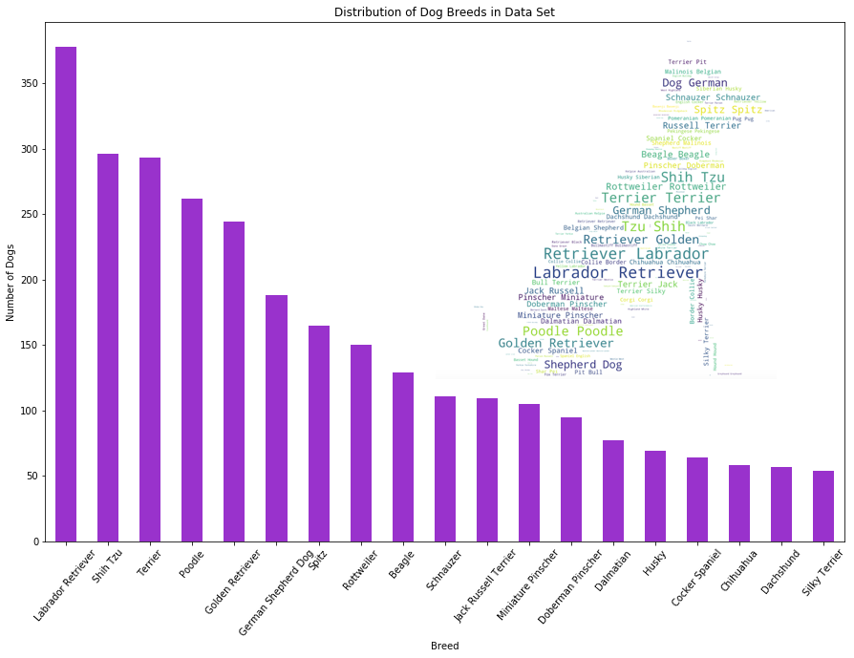
Breed
Notes:
However, Labrador’s are just as popular as they are here in the U.S. Shih Tzu’s and Terriers are the second and third most popular dogs. (Fig. 4, pg.4) Statistical tests confirm that there is a relationship between breed and adoption speed, and between mixed/purebred and adoption speed. However, the actual breed has more of an impact than whether a dog is mixed.

Slide 11
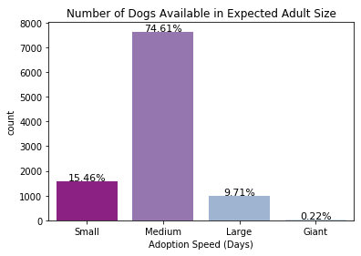
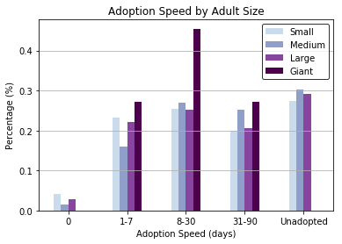
Exploratory Data Analysis - Adult Size
Notes:
The size of the dog also plays a role here in the U.S., with medium size breeds being more popular. In Malaysia, giant breeds are very quickly adopted, likely due to their scarcity, as they make up 0.22% of the data set. Otherwise, size has very little effect on adoption speed in Malaysia. Statistical tests confirm this relationship

Slide 12
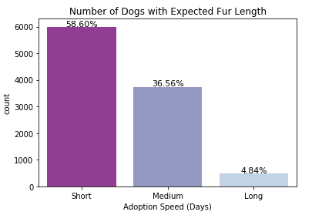
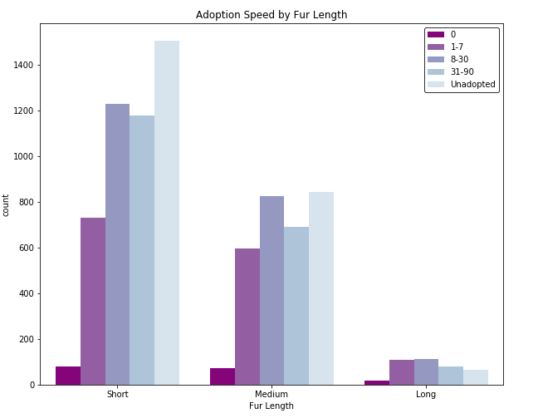
Exploratory Data Analysis - Fur Length
Notes:
When it comes to appearance, in the U.S., there’s definitely an impact. Fur length is more of a factor in certain regions, but overall doesn’t make much of a difference in adoption speeds. In the dataset, it appears that dogs trend towards shorter coats. While there is some difference between the distributions (Fig. 6), statistical testing shows that between fur length and adoption speed are not highly correlated but there is a relationship between the features.

Slide 13
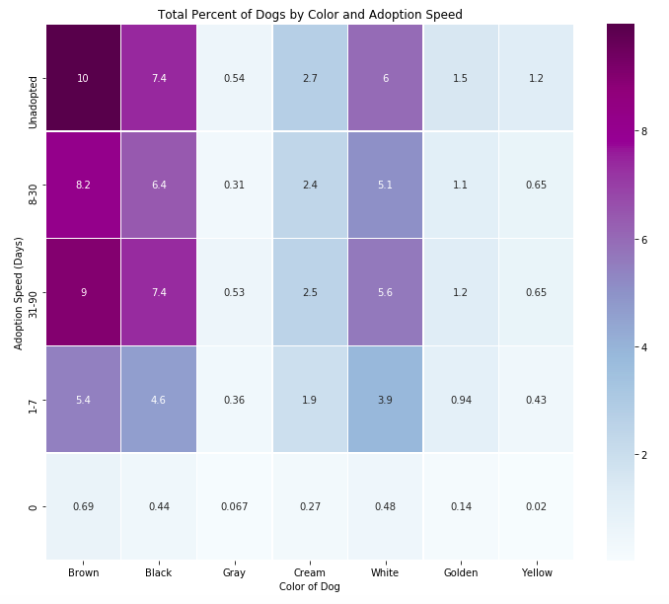
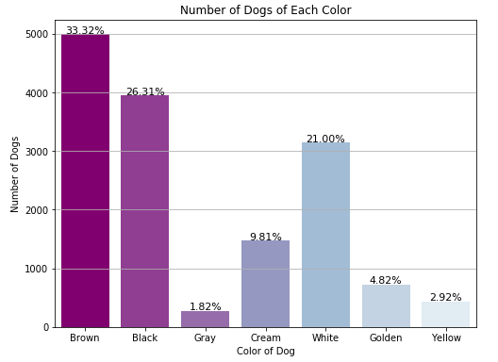
Exploratory Data Analysis - Color
Notes:
While fur length doesn’t make much of a difference in the dog’s adoption speed in the US, the color does. There’s a well known phenomenon in the U.S. adoption groups that indicates black, or darker colored dogs go largely unadopted. This is thought to be because they appear intimidating, and they also do not photograph well. In Malaysia fur length also has very little effect on adoption speed. However, as expected, darker color dogs go unadopted more often. This may in part be due to the large number of dark colored dogs that are available. Additional investigation would be needed for conclusive evidence, but it appears the trend holds. One interesting observation of note is that golden colored dogs and yellow colored dogs are separated into two groups. At first glance it appears that yellow dogs are also very unlikely to be adopted, but when combined with golden dogs this trend disappears.

Slide 14
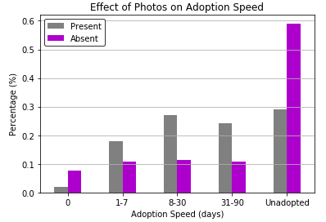
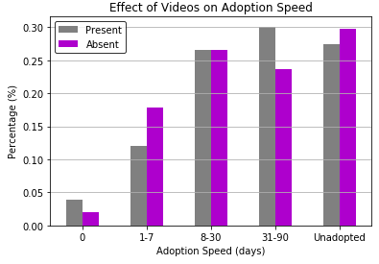
Exploratory Data Analysis - The Listing

Slide 15
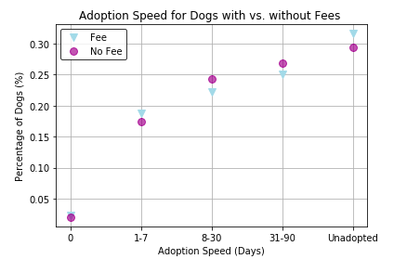
Exploratory Data Analysis - Fee

Slide 16
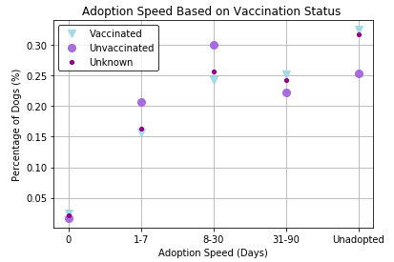
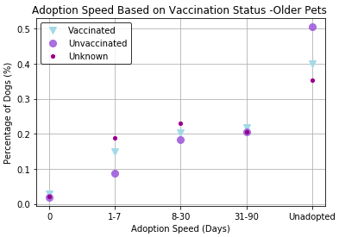
Exploratory Data Analysis - Health
Health trends have less effect on adoption speed
Puppies medical history has a large effect on how health relates to adoption speed
When removing puppies from the dataset, health only matters for pre-existing medical conditions, which is unsurprising as every other health feature studied is changeable by a veterinarian

Slide 17
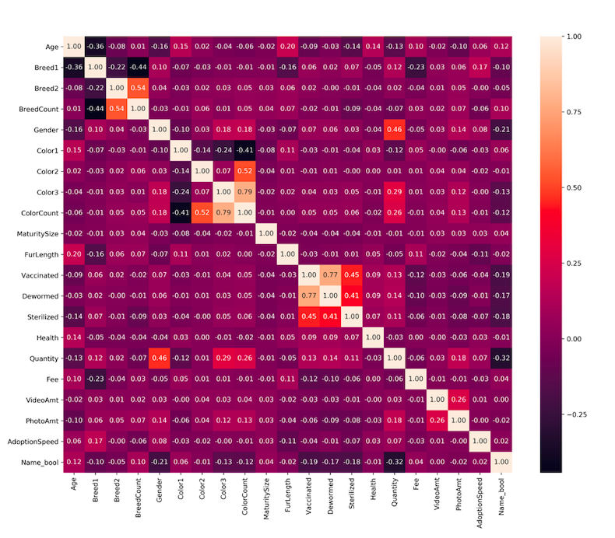
Statistical Analysis
Notes:
Interestingly enough, from this plot, it becomes evident that no single feature has an overwhelming impact on adoption speed. Those features with the highest impact are Breed, Gender, Age, and presence of a name.
As we're mostly concerned with how each variable relates to adoption speed, only those relationships previously mentioned were investigated during machine learning and model development

Slide 18
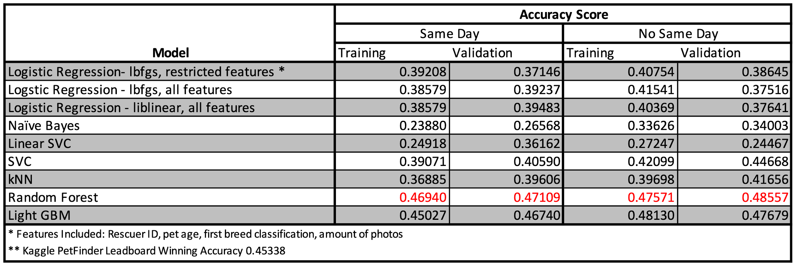
Model Development

Slide 19
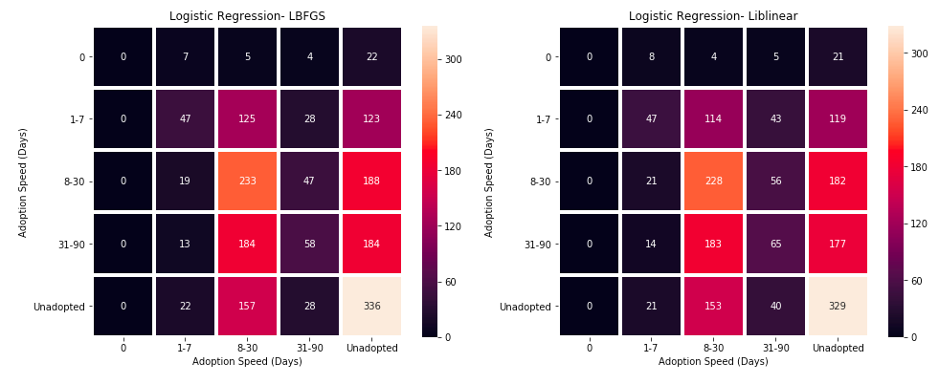
Logistic Regression

Slide 20
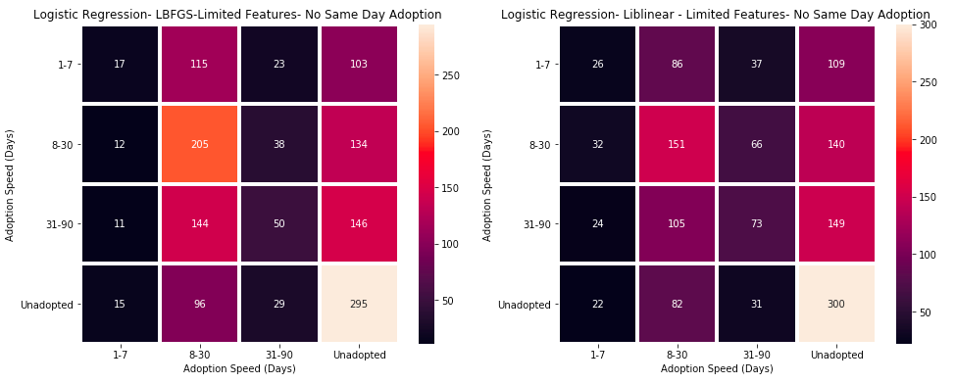
Logistic Regression - No Same Day Adoptions

Slide 21
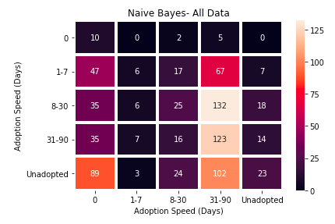
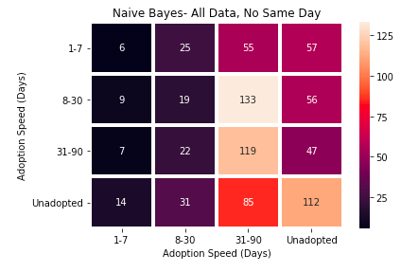
Naive Bayes

Slide 22
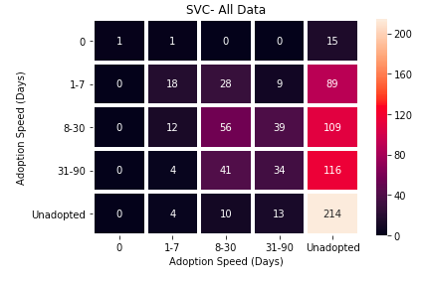
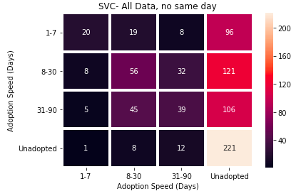
Support Vector Classification

Slide 23
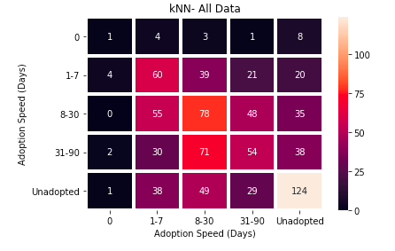
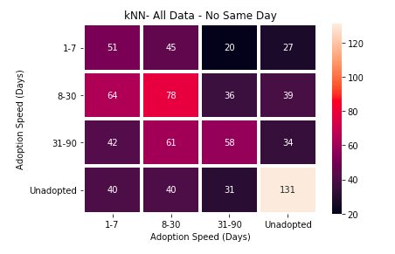
K Nearest Neighbors

Slide 24
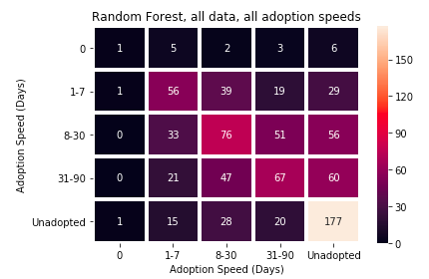
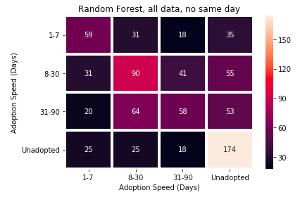
Random Forest

Slide 25
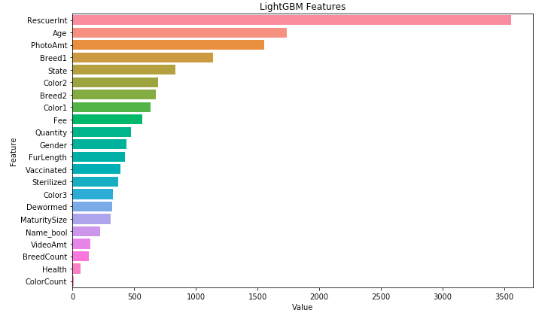
Light GBM - Features Analysis

Slide 26
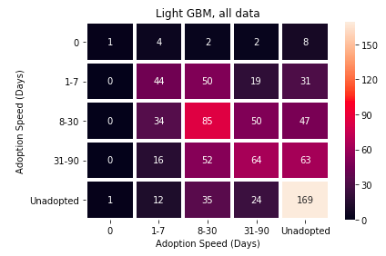
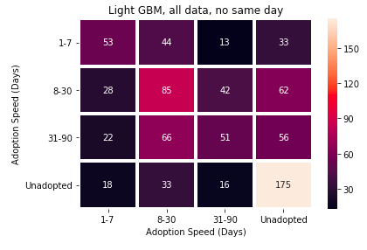
Light GBM

Slide 27
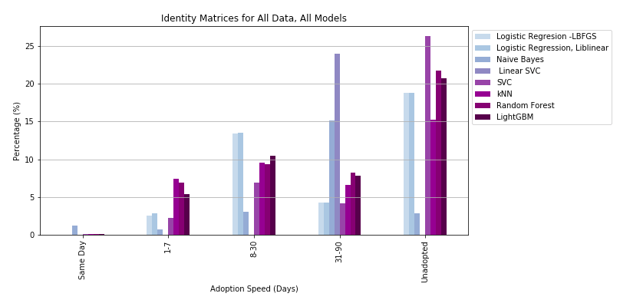
Model Results- All Pets

Slide 28
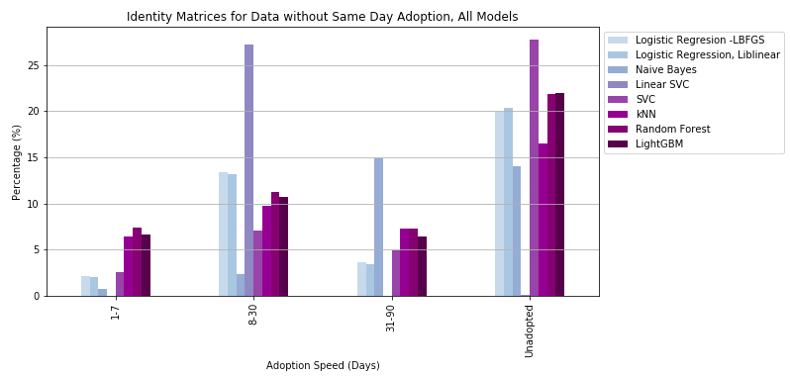
Model Results - No Same Day Adoptions

Slide 29
Recommendations
Focus more on which rescue has success with adopting out a specific type/breed of animal
The best chance of predicting a same day adoption is to use the logistic regression model using a liblinear solver.
The second step in analyzing a new pet during intake should be to run LinearSVC, and keep those pets who will be adopted in the first month if capacity is available.
To determine those pets who will require a more medium duration stays (<90 days), utilize the Naive Bayes model
To predict those pets who will require long term care, and possibly rehoming to an more targeted rescue, specialized training, etc. utilize the following models: SVC, kNN, Random Forest, or Light GBM.
An averaged prediction for all models can also be utilized.

Slide 30
Dataset Limitations
Understanding interactions between listings opening and closure- how is “adoption speed” defined. Are animals that go unadopted simply not updated listings?
Understanding how unique identifiers are assigned - is it possible for a pet to change rescues and have multiple listings for the same animal with different outcomes?
Understanding how breed is determined for listings - is it appearance based or DNA based?

Slide 31
Opportunities for Future Work
Repeat with pull from US PetFinder API and compare relationships
Explore rescuer specific models for each agency
Explore different relationships within the data - breed, description, etc.
Explore area statistics and correlate to data: state legal policies with regards to animals, economic and housing statistics
Develop a model to reliably clean the “name” feature for application acros the entire dataset
Expand to study effects and reactions with adoption for cats
Develop a predictor model based on location, rescue history, etc. to use fore ach pet’s intake

Slide 32

Thank You
Caitlin Jansson
caitlinjejansson@gmail.com
Project GitHub Repository

